Slide 1

Quality Management Systems -
Requirements based on
ISO 9001:2015[E]
ISO 9001:2015 AWERENESS
FOR
MANAGEMENT & STAFF
BY
WINYANA TRANSFORMATIONS

Slide 2

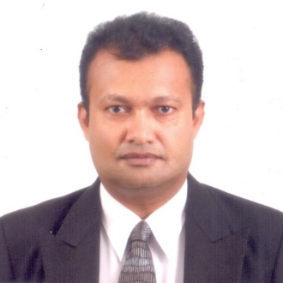
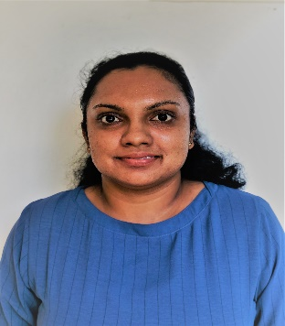
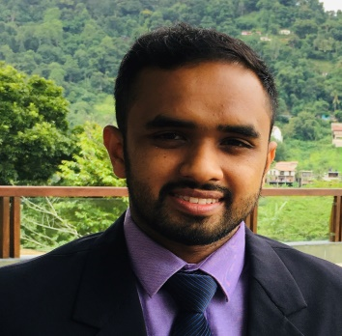
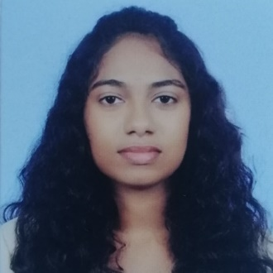
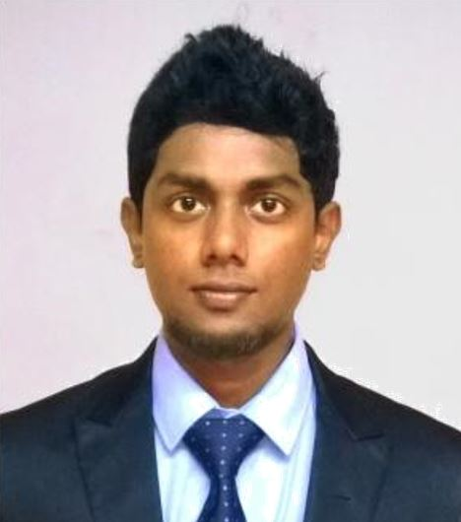
In House Team
Chaminda Karunanayake
-Director Business Development –
(MSc Herriot Watt, MBA-USQ, PhD candidate (Sri Jaya))
Sugath Hettiarachchi
-Director System implementation-
(DOSH, DQA, Lead Auditor EMS,QMS, OHMS, BSc-Colombo)
Madusha Sewwandi
-QA & Project Lead-
(HND-Food Science)
Isuru Denagamage
-Marketing & Brand Executive
(BSc (Hons) in Agriculture, PGdip Marketing (SLIM) )
Asheni Silva
-Compliance Specialist-
(LLB-UK, LLM-Candidate)
Pravinda Bhagya
-Consultant-
BSc, MSc, PhD(Candidate-Aus)

Slide 3















Our Experience

Slide 4


Content
Project team-introduction
Why Quality and Endorsement
ISO 9001 Structure and Content
References
1
2
3
4

Slide 5


Introduction to ISO 9001: 2015
ISO 9001:2015 is an international standard dedicated to Quality Management Systems (QMS).
The QMS is the aggregate of all the processes, resources, assets, and cultural values that support the goals of customer satisfaction and organizational efficiency.

Slide 6




ISO 9001:2015 QUALITY MANAGEMENT SYSTEM
6. Performance
Evaluation
5. Operations
4. Support
6
5
4
7. Improvement
7
3
1
2
6
7
5
PRINCIPLES
4
1
3
2
3. Planning
1. Context of the Organization
2. Leadership

Slide 7
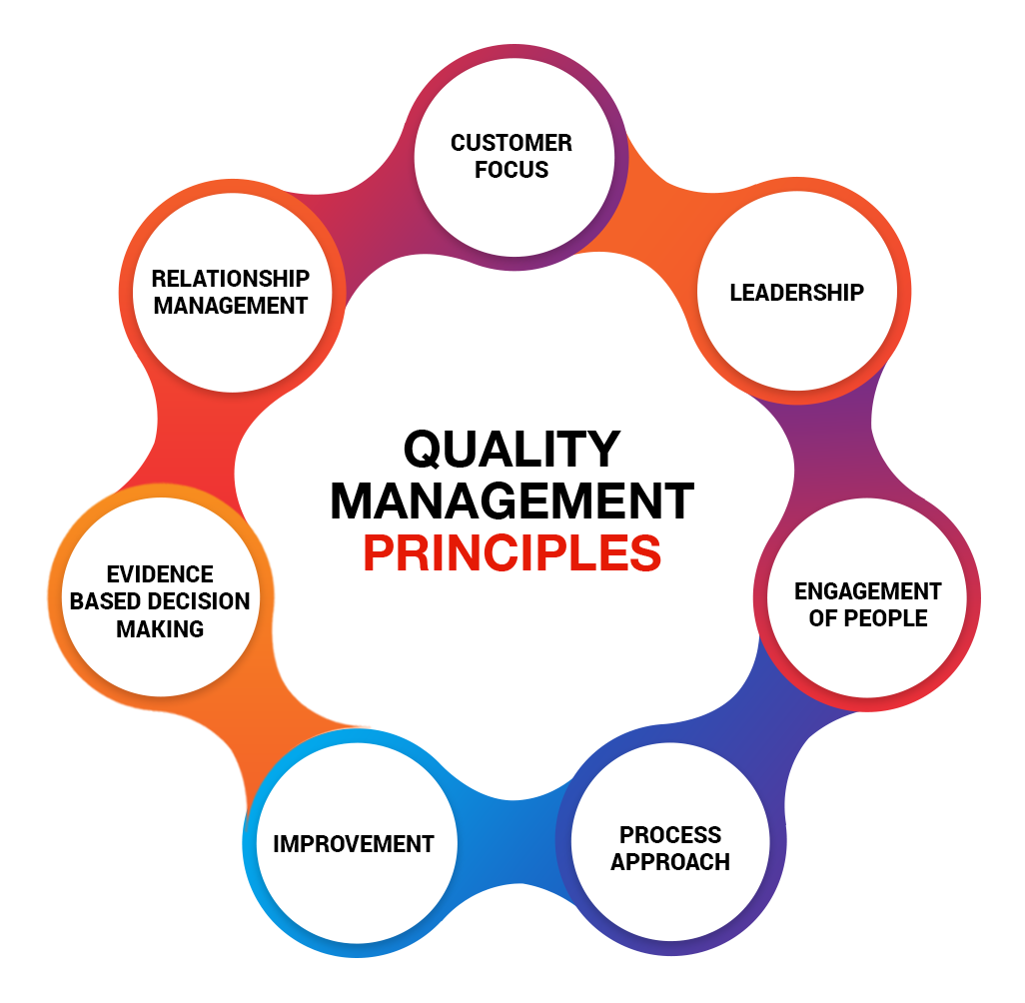

Slide 8
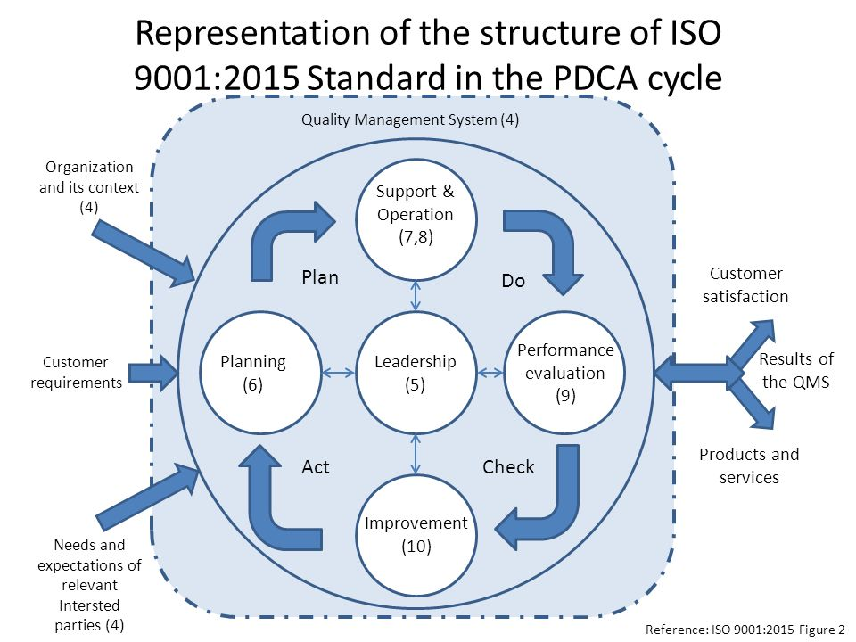

Slide 9
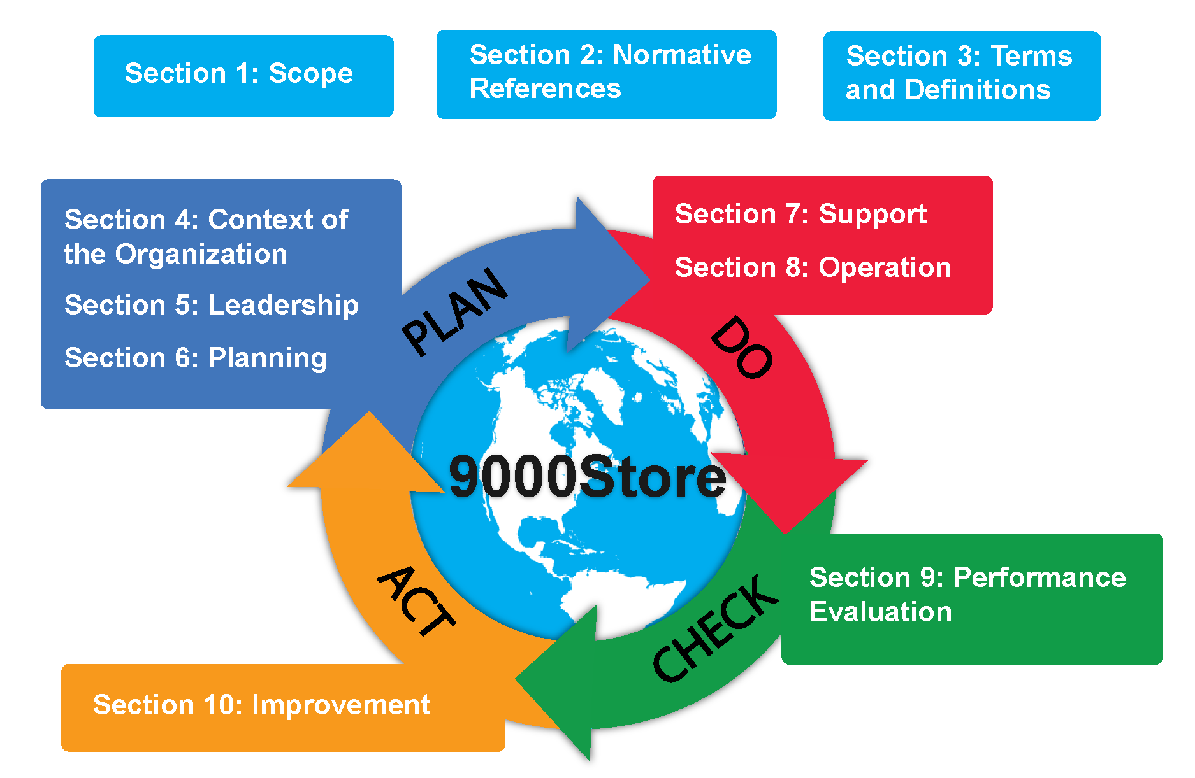
PDCA

Slide 10
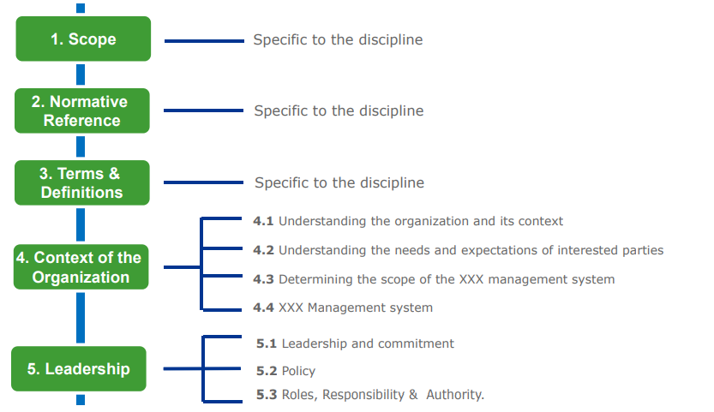
High Level Structure of ISO-X

Slide 11
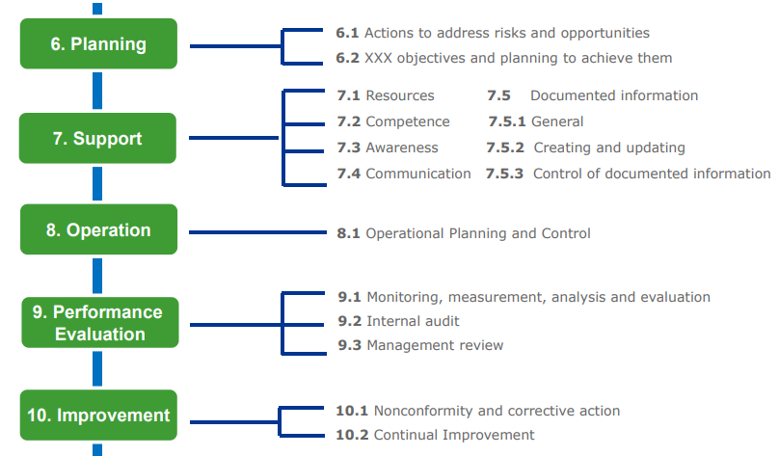

Slide 12
Clause 4: Context of the organization
4.1 Understanding the Organization and its context
4.4
Quality Management system
4. Context of the Organization
4.2
Understanding the needs and expectations of interested parties
4.3
Determining the scope of the quality management system

Slide 13
Clause 5: Leadership
5.1 Leadership & Commitment
5.2 Quality Policy
5.3 Organizational Roles , Responsibilities & Authorities

Slide 14
Clause 6. Planning
6.1 Actions to address risks & opportunities
Planning
6.3 Planning of changes
6.2 Quality objectives & planning to achieve

Slide 15
Clause 7: Support
7.1 resources
7.5 Documented Information
7.2 Competence
Support
7.4 communication
7.3 Awareness

Slide 16
Clause 8 : Operation
Operation
8.1 Operational planning and control
8.2 Requirements for products and services
8.3 Design and development of products and services
8.4 Control of externally provided processes , products and services
8.5 Production and service provision
8.6 Release of products and services
8.7 Control of nonconforming outputs

Slide 17
Clause 9: Performance evaluation
Performance Evaluation
9.1 Monitoring, measurement, analysis and evaluation
9.2 Internal Audit
9.3 Management Review

Slide 18
Clause 10: Continual Improvement
10.1 General
10.2 Nonconformity and corrective action
10.3
Continual improvements
Continual Improvement

Slide 19
Benefits of ISO 9001:2015
Become more cost-efficient
Improved risk management
Increased credibility and competitiveness
Lower costs and shorter cycle times through effective use of resources
Enhanced customer satisfaction and improved customer loyalty
Increased revenue and market share
Improved communication, planning and administration process

Slide 20
FUNDAMENTAL REASONS FOR EXISTENCE OF AN ENTERPRISE
KEY
DRIVING
FORCES
Profitability
Expanded Market share
Long term survival
Service to Society

Slide 21

ESSENTIAL FACTORS FOR SURVIVAL AND GROWTH OF AN ENTERPRISE
    > High Quality
    > Increased Productivity
    > Cost Effectiveness
    > Efficiency
Quality is the key to productivity, profitability, survival and growth

Slide 22
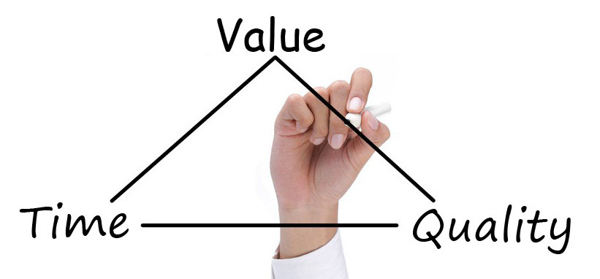
Quality – WHY ?
Unprecedented interest in Quality both on the part of Industry & trade and Society in General.
Rapid changes in technology, environment, economic aspects, trade patterns.
Abundance of product variety, complexity, innovativeness.

Slide 23
What is a process?
Process
(a value-adding
set of activities)
Outputs
Inputs
Resources

Slide 24
Corporate Operating Philosophy
VISION
MISSION
QUALITY POLICY
QUALITY OBJECTIVES

Slide 25
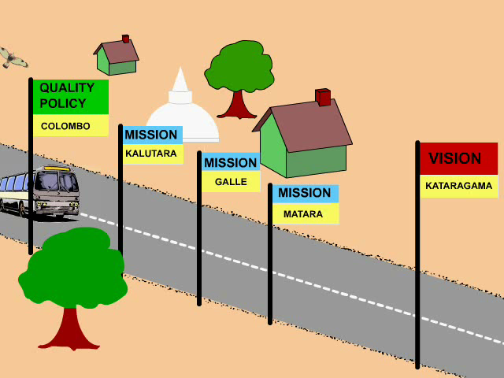

Slide 26
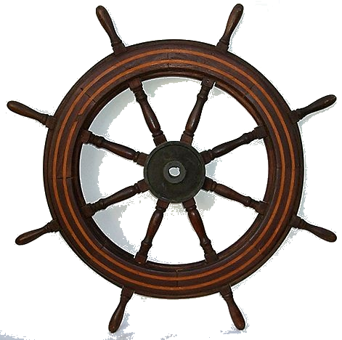
INTERESTED PARTIES
CUSTOMERS
SHAREHOLDERS
PUBLIC
SUPPLIERS
EMPLOYEES

Slide 27





011 2576616 , 0777 169339, 071 600 4411
info@winyana, support@isoconsultancy.lk
No. 20, Kothalawala Avenue, Colombo 04.

